Slide 1
Module 1: Properties and Handling of Particulate Solids (Chapter 28)
Lecture 2
Somak Chatterjee

Slide 2
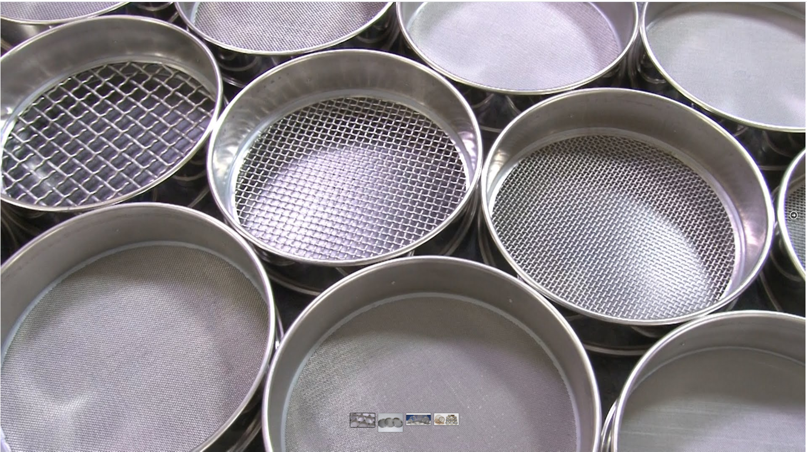
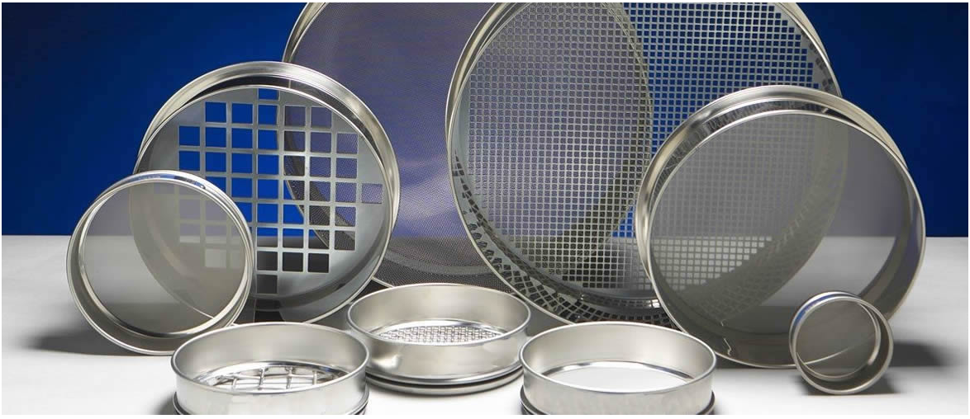
Screening Analysis
Screen Size
1 mm
0.5 mm
Reference: www.bangalorewiremesh.com/product/test-sieves/

Slide 3
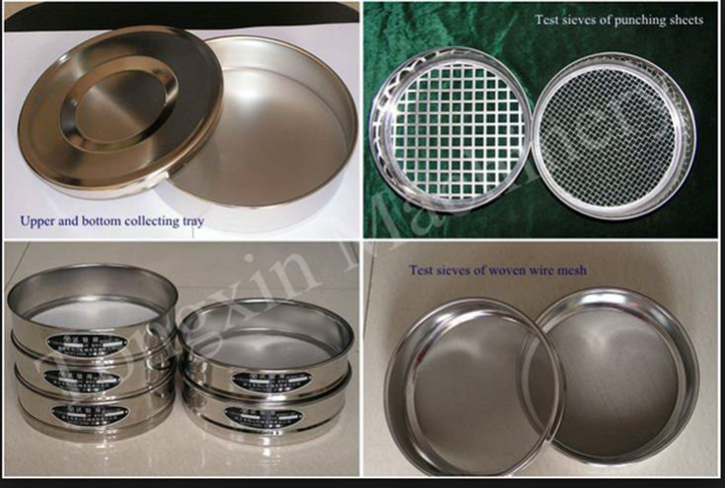
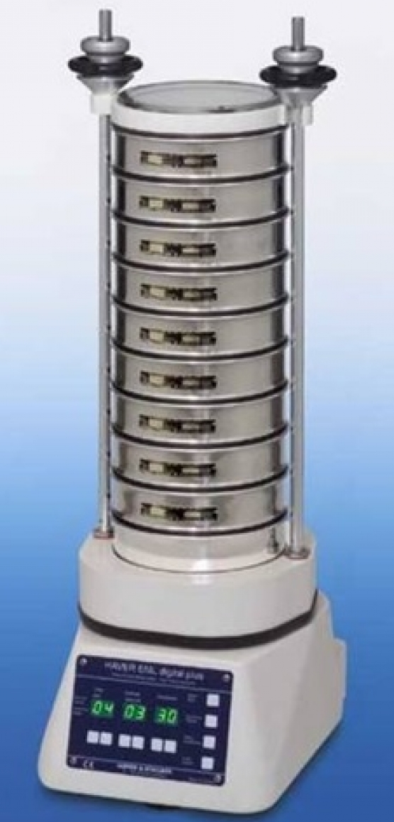
Screening Analysis
10 mesh
200 mesh
Bottom Tray
Reference: www.scientificservices.eu/item/laboratory-test-sieves-200-mm-diameter/1506

Slide 4
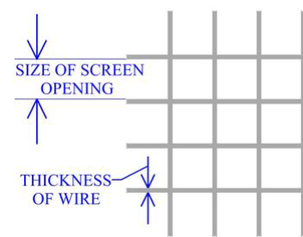
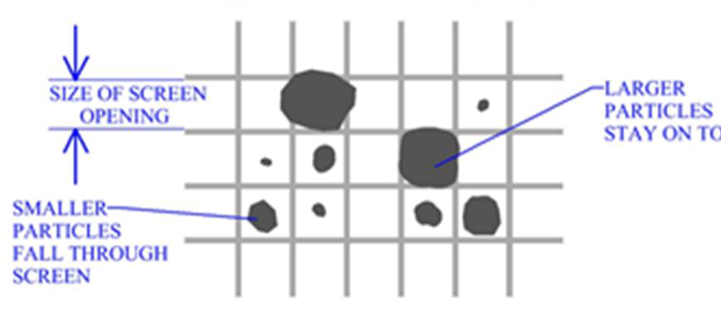
Screening Analysis
Mesh Number = Number of opening per linear inch
Clear opening (inches) = $\frac{1}{mesh number}−wire thickness$

Slide 5
Screen Analysis
List of standard test screens
  BSS= British Standard Screen
  IMM= Institute of Mining & Metallurgy
  U.S. Tyler mesh (Appendix 5 of textbook)
  US. ASTM= American Institute for testing Materials

Slide 6
Tyler Series screen scale (Appendix 5)
Size of the opening
Mesh Number

Slide 7
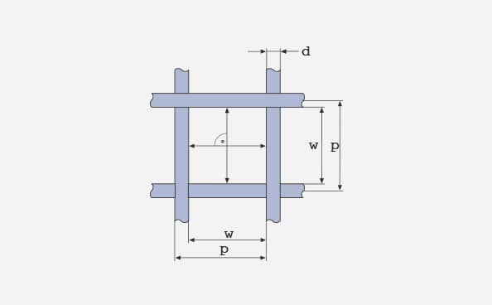
Tyler Series screen scale (Appendix 5)
Aperture width (labeled w in the below diagram) is the distance between two adjacent warp or weft wires, measured in the projected plane at the mid positions.
Warp: All wires running lengthwise of the cloth as woven.
Weft: All wires running across the cloth as woven.
Wire diameter (d) is the width of the wires in the woven cloth. (The wire diameter may be altered slightly during the weaving process.)
Pitch (p) is the distance between the midpoints of two adjacent wires. Represents the sum of the aperture width (w) and wire diameter (d).

Slide 8
Screening Analysis
Reference: www.scientificservices.eu/item/laboratory-test-sieves-200-mm-diameter/1506

Slide 9
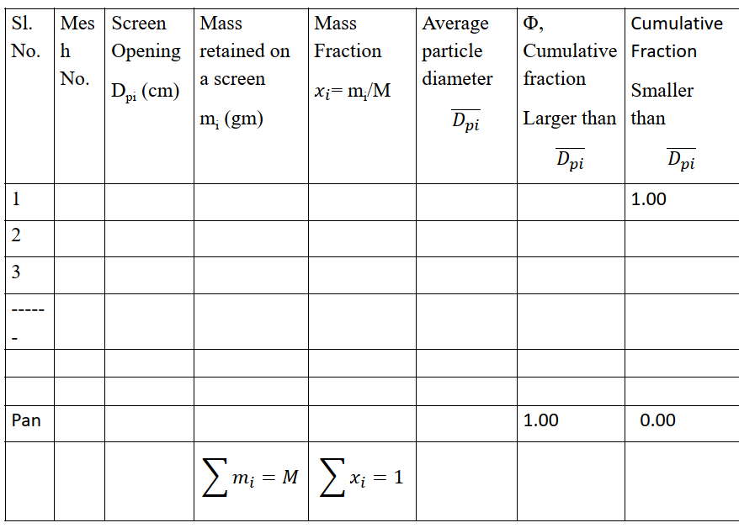

Screening Analysis
The notation $14/20$ means "through 14 mesh and on 20 mesh.“
The notation $−14+20$means “pass through 14 and retains on 20 mesh”
Reference: www.scientificservices.eu/item/laboratory-test-sieves-200-mm-diameter/1506

Slide 10
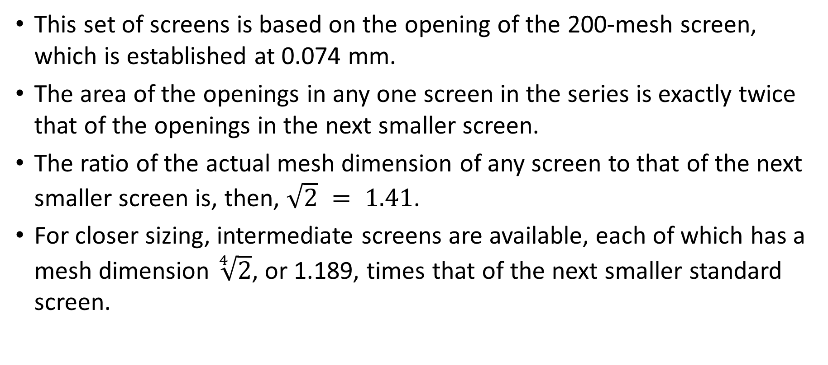
Screen Analysis (standard screen series)
This set of screens is based on the opening of the 200-mesh screen, which is established at 0.074 mm.
The area of the openings in any one screen in the series is exactly twice that of the openings in the next smaller screen.
The ratio of the actual mesh dimension of any screen to that of the next smaller screen is, then, $\sqrt{2} = 1.41$.
For closer sizing, intermediate screens are available, each of which has a mesh dimension $\sqrt[4]{2}$, or 1.189, times that of the next smaller standard screen.

Slide 11
Screen Analysis (standard screen series)
In making an analysis a set of standard screens is arranged serially in a stack, with the smallest mesh at the bottom and the largest at the top.
The sample is placed on the top screen and the stack shaken mechanically for a definite time, perhaps 20 min.
The particles retained on each screen are removed and weighed, and the masses of the individual screen increments are converted to mass fractions or mass percentages of the total sample.
Any particles that pass the finest screen are caught in a pan at the bottom of the stack.

Slide 12
Screen Analysis (standard screen series)
The results of a screen analysis are tabulated to show the mass fraction of each screen increment as a function of the mesh size range of the increment.
Since the particles on any one screen are passed by the screen immediately ahead of it, two numbers are needed to specify the size range of an increment, one for the screen through which the fraction passes and the other on which it is retained.
The material that passes through the screen is called the minus (-) material/ undersize and the material that is retained on the screen is called the plus (+) material/oversize
Thus, the notation 14/20 means "through 14 mesh and on 20 mesh."

Slide 13
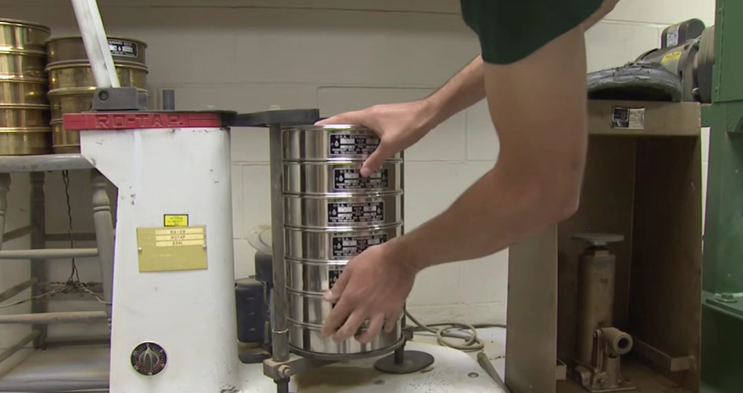
Screen Analysis (standard screen series)

Slide 14
Differential Analysis
Information from particle-size analysis is tabulated to show the mass or number fraction in each size increment as a function of the average particle size (or size range) in the increment.

Slide 15
Cumulative Analysis
Reference: www.scientificservices.eu/item/laboratory-test-sieves-200-mm-diameter/1506

Slide 16
Cumulative Analysis
Cumulative analysis is done obtained by adding, consecutively, the individual increments, starting with that containing the smallest particles, and tabulating or plotting the cumulative sums against the maximum particle diameter in the increment.

Slide 17
Example: Numerical Calculations

Slide 18
Differential Analysis vs. Cumulative Analysis
Calculations of average particle size, specific surface area, or particle population of a mixture may be based on either a differential or a cumulative analysis.
In principle, methods based on the cumulative analysis are more precise than those based on the differential analysis, since when the cumulative analysis is used, the assumption that all particles in a single fraction are equal in size is not needed.
The accuracy of particle-size measurements, however, is rarely great enough to warrant the use of the cumulative analysis, and calculations are nearly always based on the differential analysis.

Slide 19
Particle Size Analysis
The mixtures of particles having various sizes and densities, the mixture is sorted into fractions, each of constant density and approximately constant size.
Each fraction can then be weighed, or the individual particles in it can be counted or measured by any one of a number of methods.
Then apply the area and number of particles equation to each fraction and results added.

Slide 20
References
Smith, J., Harriott, P., McCabe, W. (2005). Unit Operations of Chemical Engineering. Colombia: McGraw-Hill Education.
Swain, A. K., Patra, H., & Roy, G. K. (2011). Mechanical operations. Tata McGraw Hill.

